Slide 1
FP V5 VISUALIZATION FOR KOKO HOSTS, KAMPALA
Last Updated: 10 Nov 2016

Slide 2
D
Definitions
KOKO Networks is a technology company with a suite of hardware and software technologies that is doing research to enable the safe and low-cost distribution of clean cooking fuel to urban households.
KOKO Networks is in the process of technology development and market research in Kampala. KOKO Networks plans to install one prototype KOKOpoint and SmartCook stoves with Smart Canisters deployed in Kitintale for our current 12 test users.
Who is a KOKOpoint Host?
This is a small business owner that agrees to partner with KOKO Networks to install and host our KOKOpoint on their premises for research purposes.
The HOST agrees to permit minor modifications to their premises in order to enable the safe external refilling of the KOKOpoint on a regular basis with denatured bioethanol cooking fuel (known as SMART FUEL).
The HOST also agrees to use its best efforts to protect and secure the KOKOpoint.
What is a KOKOpoint?
Automated and self service dispenser of KOKO fuel.
Ultra safe, vapor tight dispensing ,remote monitoring technology.
Ultra low power with 48 hours backup.
Connected to KOKOnet cloud services.
What is SmartCook?
SmartCook is a modern clean cooking solution that includes a 2 burner stove and a vapor tight refillable canister.

Slide 3
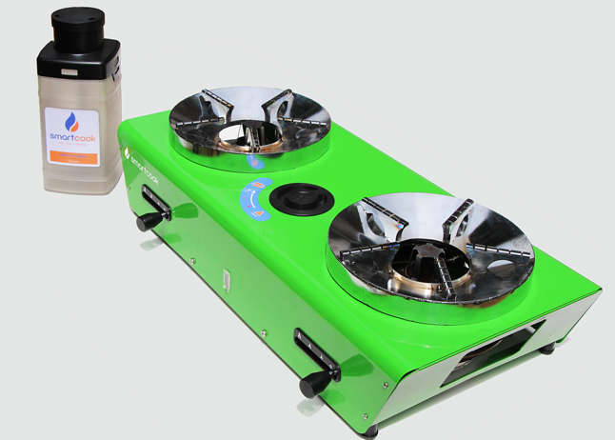
SMARTCOOK STOVE AND CANISTER
SmartCook stove and Smart Canister
Clean
No smoke, no smell, no fuel handling
Ultra Safe
Uncompressed, no explosion risk & safe for children to use
Fast
Start cooking immediately, no waiting
Affordable
Lowest cost 2-burner modern cooking experience

Slide 4
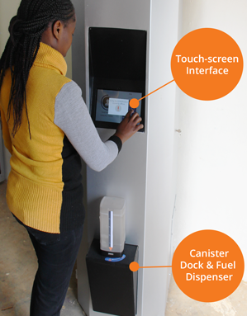
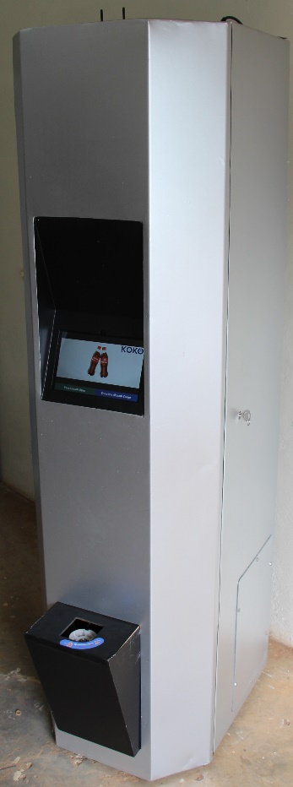
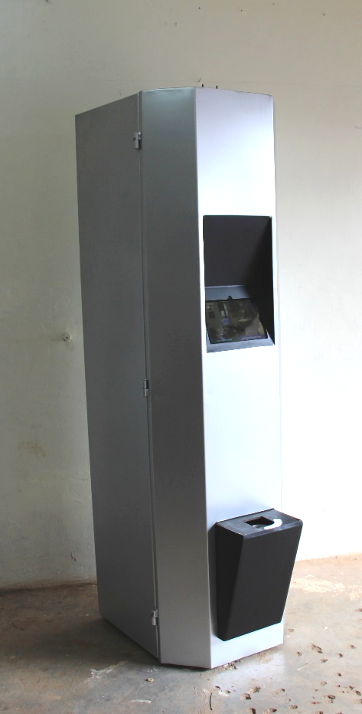

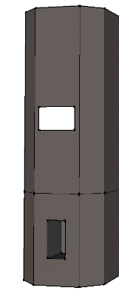
KOKOPOINT DETAILS
Refilling Lock Box outside the shop
Power Connection With Meter
KOKOpoint dimensions
Height:- 1.97 meters
Width:- 0.648 meters
Depth:- 0.6 meters
Other requirements
6 to 8 holes to bolt the KP to the wall
10-15 cm diameter hole in wall or vent for all pipes needed for refilling the KOKOpoint.

Slide 5
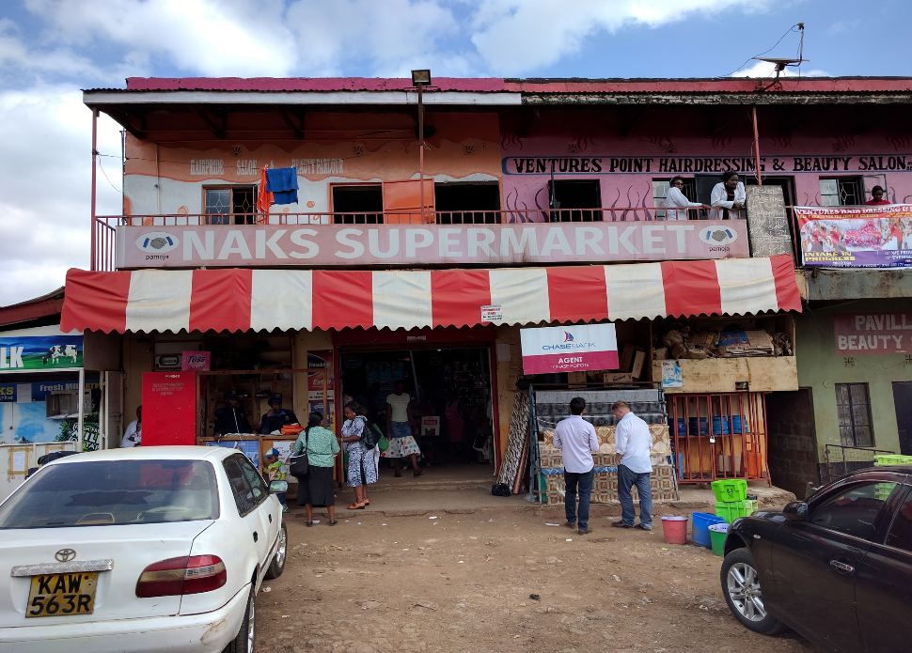
EXAMPLE OF A KOKO HOST SHOP
Refilling box in front of building with pipes to the KOKOpoint inside
‹#›

Slide 6
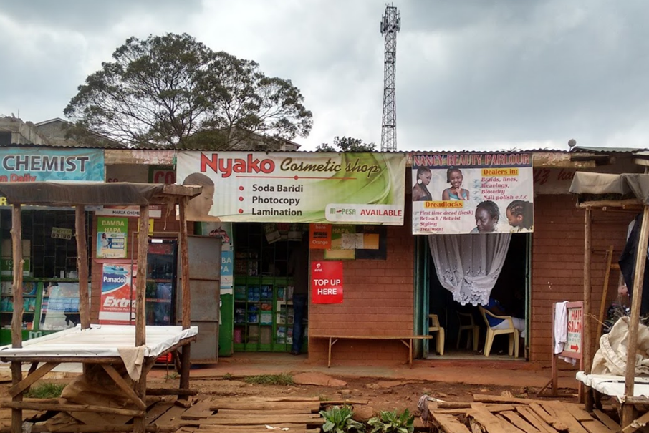
Refilling box in behind the sign with pipes going through wall to the KOKOpoint inside
KOKOpoint behind here
EXAMPLE OF KOKO HOST SHOP
‹#›

Slide 7
Show Video here
Please download and have offline on the company tablet

